Slide 1

IRS AssignmenT Task 1 + 2
Muhammad Wajeeh Uz Zaman

Slide 2
The Best Way To Do Something is By Divide And Rule
We create, small files, small functions and use loops to accomplish our tasks.

Slide 3
Software Specifications
Python (x64 Bit)
Python Version: 3.6.8
PyScripter IDE for Coding.
PiP For Installing Dependencies

Slide 4
Libraries Used
List of libraries installed with pip are given in libraries.txt attached with this presentation.
Important Ones Are;
NLTK (For Stemming, Lemmatization And Stopwords Removal)
PDFMiner, PDFMiner.SIX, PyPDF2, PDFMiner2 and tika for PDF files manipulation.
numpy for array handling.

Slide 5
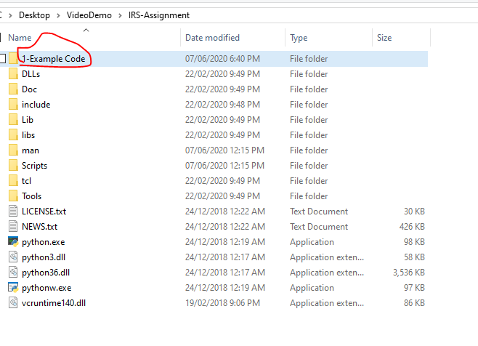
Code Hierarchy

Slide 6
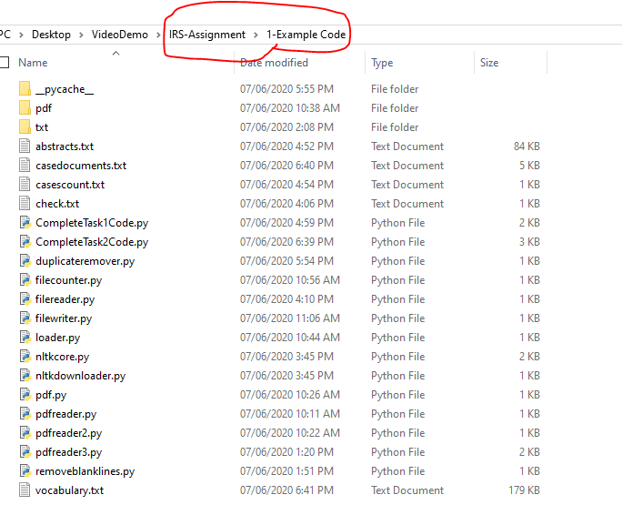
Code Hierarchy

Slide 7
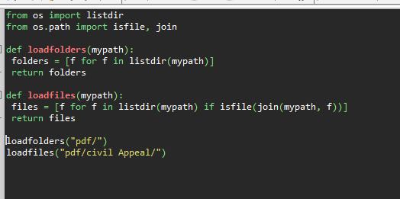
loader.py
load files and sub-folders of a given directory
loadfolders function take path as input and give an array subdirectories.
loadfiles function take path as input and return array of files of that folder.

Slide 8
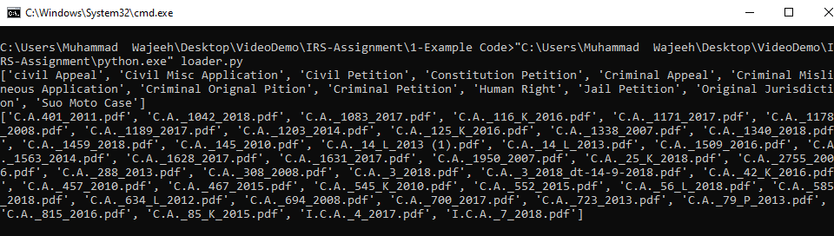
loader.py
load files and sub-folders of a given directory

Slide 9
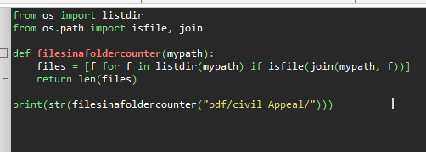
filecounter.py
contains a function that take a path as input, count its files and return number files in folder

Slide 10
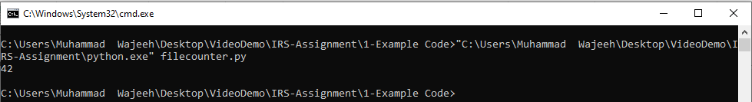
filecounter.py
contains a function that take a path as input, count its files and return number files in folder

Slide 11
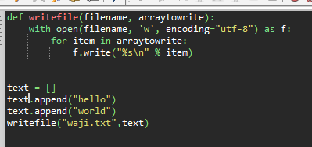
filewriter.py
Contains a function that takes inputs filename to save file and array to save within that file.
We use it to write abstracts, and number of cases in folders with this function.

Slide 12
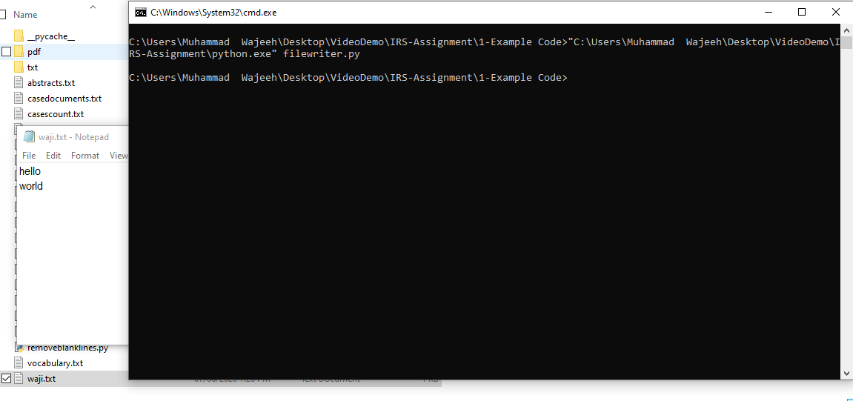
filewriter.py
Contains a function that takes inputs filename to save file and array to save within that file.
We use it to write abstracts, and number of cases in folders with this function.

Slide 13
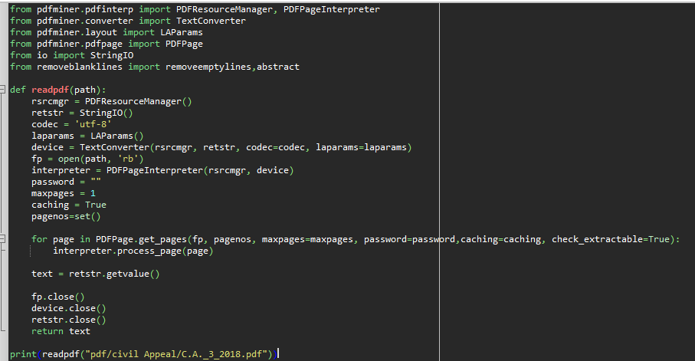
pdfreader3.py
Contains readpdf function that takes pdf path as input, and return text of pdf.

Slide 14
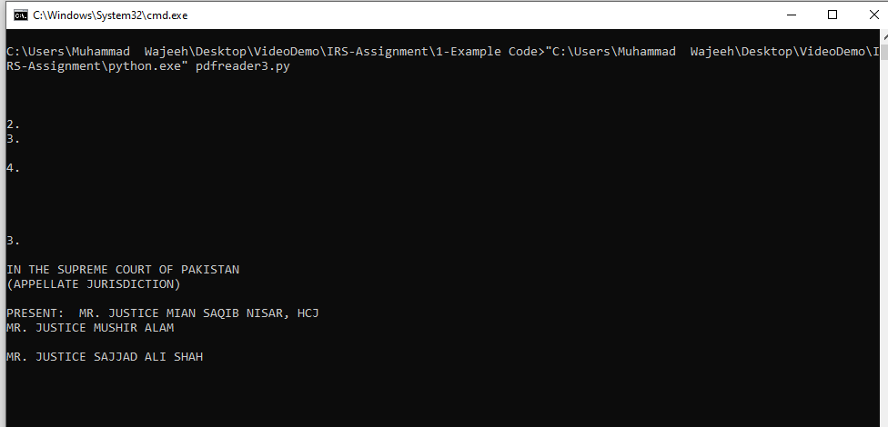
pdfreader3.py
Contains readpdf function that takes pdf path as input, and return text of pdf.

Slide 15
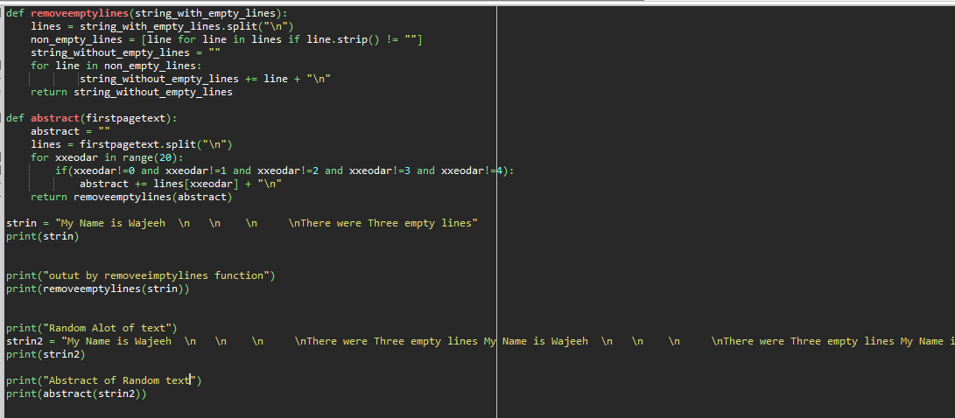
removeblanklines.py
contains two functions. 1 removes blank lines from pdf text fetched. other gives abstract of pdf (first 20 liens of pdf text)

Slide 16
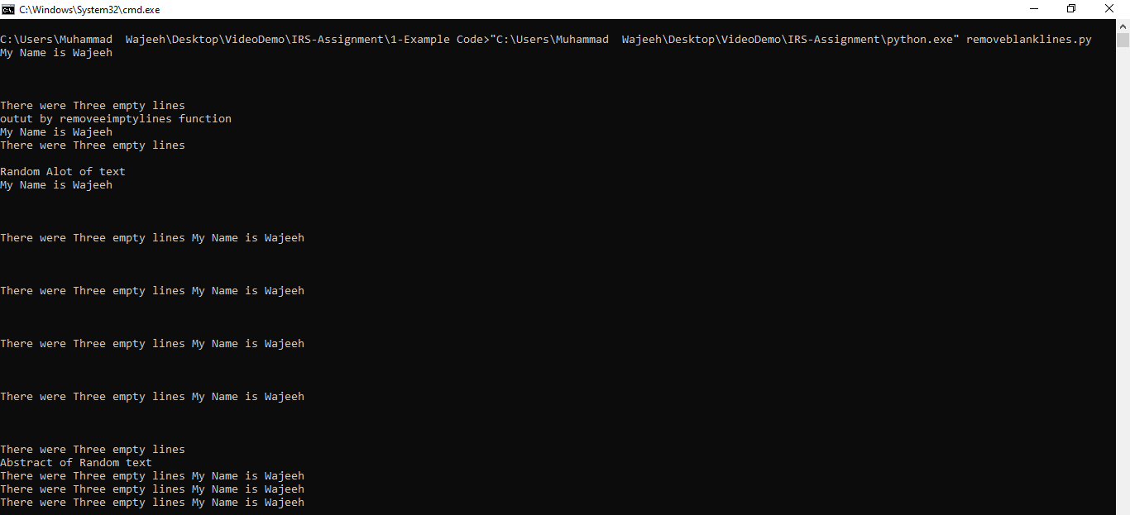
removeblanklines.py
contains two functions. 1 removes blank lines from pdf text fetched. other gives abstract of pdf (first 20 liens of pdf text)

Slide 17
CompleteTask1Code.py
Uses above python files to get folders and files from “pdf” folder. The retrieve its abstract. along with id that we increment in loops. Retrieves number of documents within folders. save the abstract and documents count in folders.
Make Two artifacts.
abstracts.txt (for saving abstracts.) Assignment task 1. part 1.
casescount.txt (to count number of judgements in each folder) Assignment task 1. part 2.

Slide 18
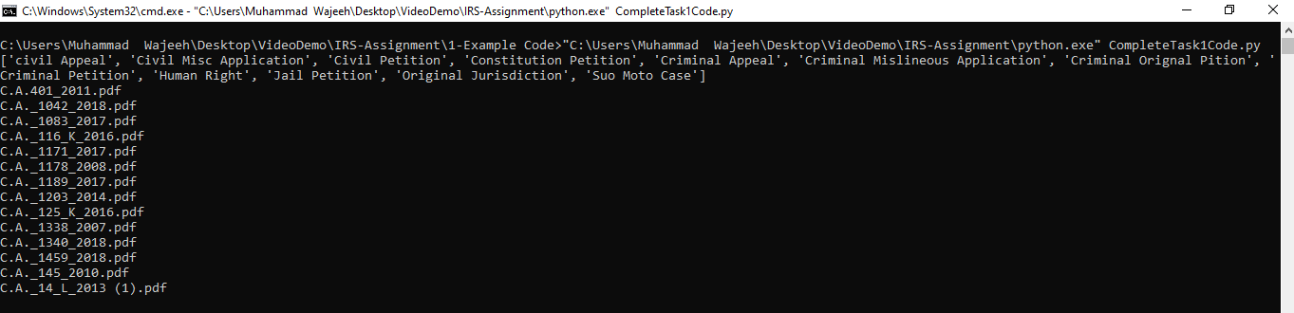
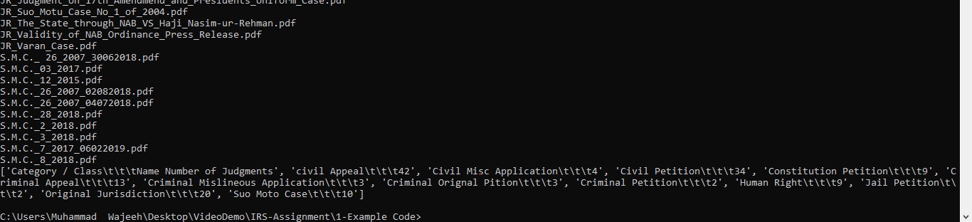
CompleteTask1Code.py (Output)(Console)

Slide 19
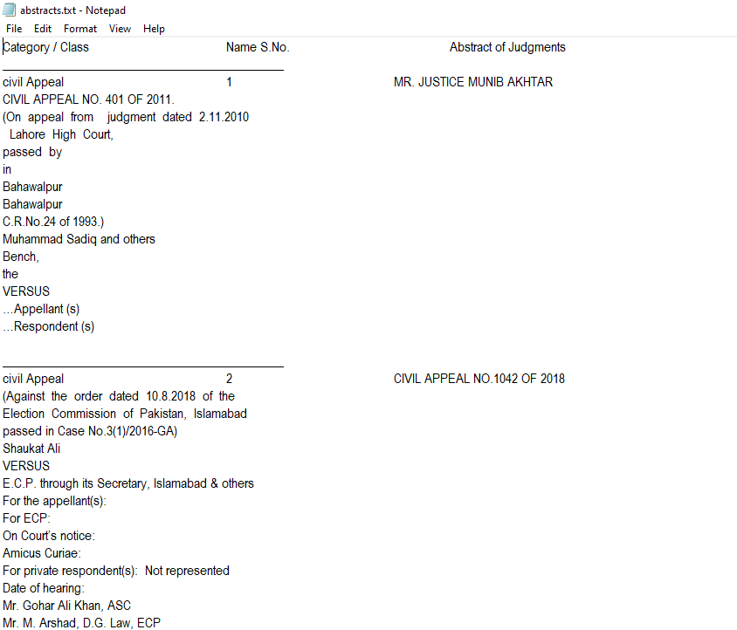
CompleteTask1Code.py (Artifacts)(abstracts.txt)

Slide 20
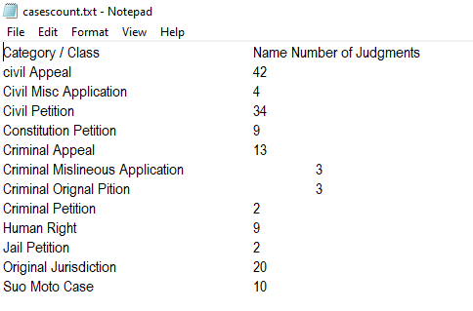
CompleteTask1Code.py (Artifacts)(casescount.txt)

Slide 21
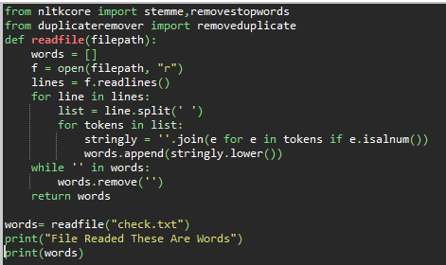
filereader.py
Contains Function That Read Words from File From A Given Path And Return words array of file.

Slide 22
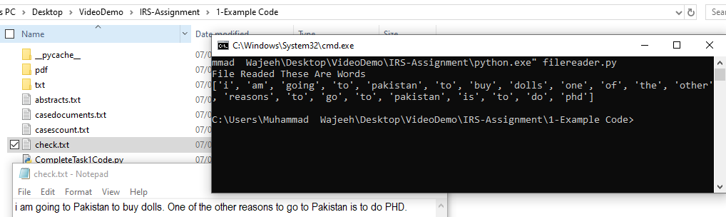
filereader.py

Slide 23
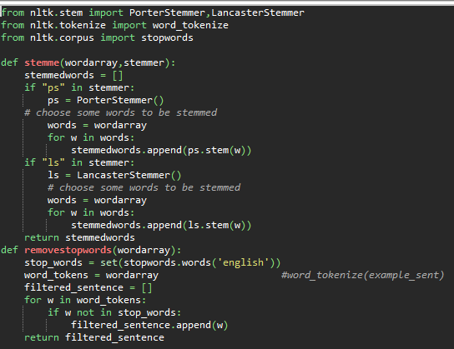
nltkcore.py
contains two functions.
stemme: takes word array for stem and method of stemming.
“ps” for porterstemmer
“ls” fpr lancasterstemmer
But i am using porterstemmer.
Because it is widely used in IR systems.
removestopwords: take words array as input.
iterate over it.
checks and removes stopwords.
returns cleaned wordarray.

Slide 24
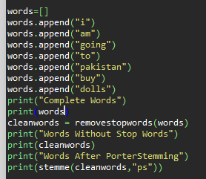
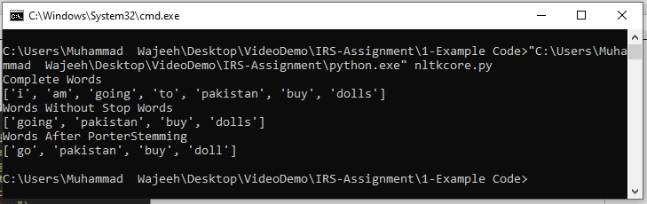
nltkcore.py

Slide 25
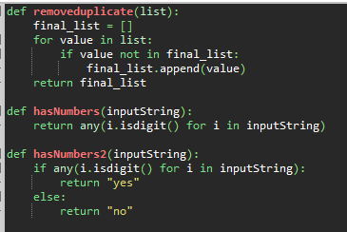
duplicateremover.py
It has 3 functions.
removeduplicate: takes word array, and remove duplicate words.
hasnumber.: take word as input. and if that word has a single character number it returns false, else true.
hasnumber2: same as hasnumber, but returns string rather than booleans.

Slide 26

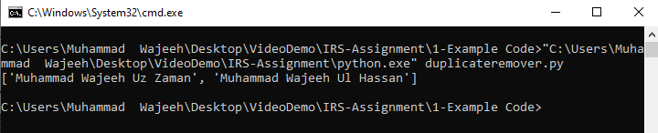
duplicateremover.py

Slide 27
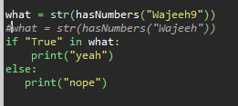
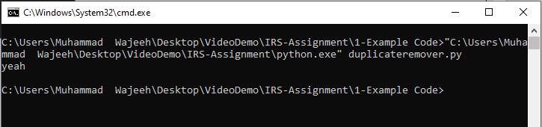
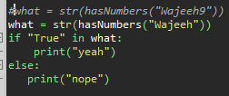
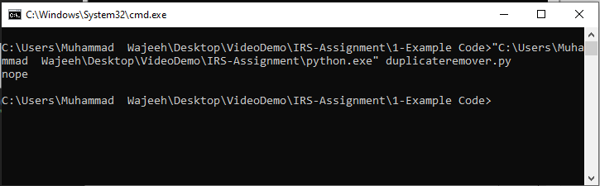
duplicateremover.py

Slide 28
CompleteTask2Code.py
Complete Task 2 Code.
Read All Text Files
Extract Words.
Perform Lemmatization.
Perform Stopword Removal.
Perform Duplicate Removal.
Identifying words.
Identifying judgements.
Gives Two Artifacts
casedocuments.txt: Contains ID and name of judgement file.
vocabulary.txt: Gives wordid and words from all of the files.

Slide 29
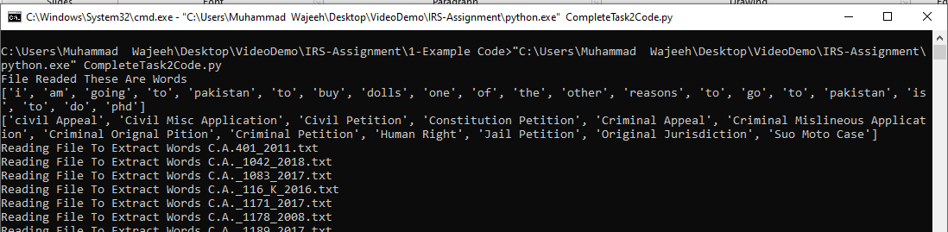
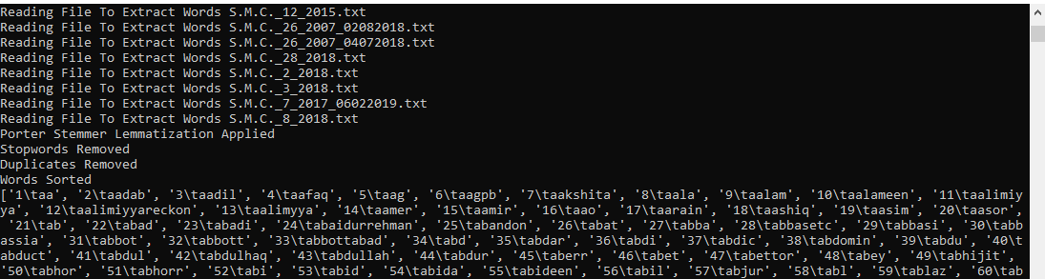
CompleteTask2Code.py (Output)(Console)

Slide 30
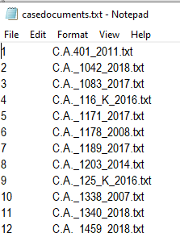
CompleteTask2Code.py (Artifacts)(casedocuments.txt)

Slide 31
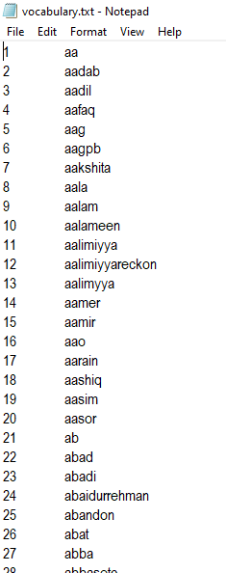
CompleteTask2Code.py (Artifacts)(vocabulary.txt)

Slide 32
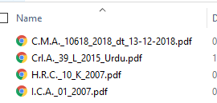
Outliers
4 PDF Files Were Deleted. As They Were Image PDFs And There was Urdu Unicode text in it.

